Slide 1
Warehouse Inventory & Reorder System
Tracking products brought in, purchased and returned
Keerthi Chowdary- 2620030196
K.V. Harshini- 2620030195
B.Tech Computer Science | Java

Slide 2

Problem Statement
Stock is often kept in registers or spreadsheets and updated by hand when goods arrive, are sold or come back as returns. A simple program is needed that updates stock automatically for each movement and never lets stock go below zero.
Wrong stock counts
Selling unavailable items
Missed or repeated entries in the register
Orders accepted for stock that is not there
Returns not recorded
No quick stock view
Returned goods never added back to stock
Staff must count shelves to know what is left

Slide 3
Abstract
Small shops and warehouses often record stock by hand, which leads to counting errors and no clear view of what is available. This project presents a simple Java program that tracks the stock of each product through three actions: products brought in from the supplier, products purchased by customers, and products returned by customers.
Stock increases when products are brought in or returned, and decreases when products are purchased. Before a purchase is recorded, the program checks that enough stock is available, so stock never goes below zero. Product names and quantities are stored in arrays, and a report shows the current stock of every product. The program is a base that can later be extended with a database, a user menu and automatic reorder alerts.
Notes:
Read the abstract in your own words. Key point: three actions change stock, and a purchase is checked first.

Slide 4
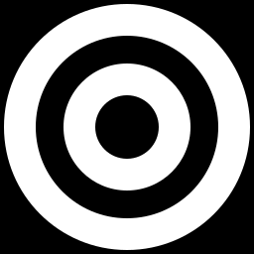
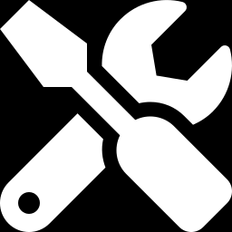
Objectives and Tools
Objectives
Tools used
Record products brought in from the supplier
Record products purchased by customers
Record products returned by customers
Block purchases larger than available stock
Show current stock of all products
Language: Java
Data storage: arrays (in memory)
Software: VS Code
Compiler: JDK (javac and java)

Slide 5
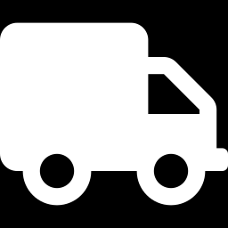
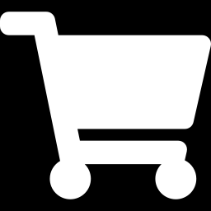
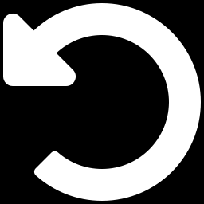
How It Works: Three Actions
Brought in
Purchased
Returned
bringProduct()
purchaseProduct()
returnProduct()
Goods arrive from the supplier
Customer buys goods; stock is checked first
Customer sends goods back
Stock goes UP
Stock goes DOWN
Stock goes UP

Slide 6
Purchase Check Logic
Yes: show "Sorry, only N available"
Is quantity more than stock?
Customer orders quantity
No: stock = stock - qty

Slide 7
GitHub Link
https://github.com/nadendlakeerthichowdary-arch/KLH-PSPJ-S16-1-TEAM-NO.-15

Slide 8
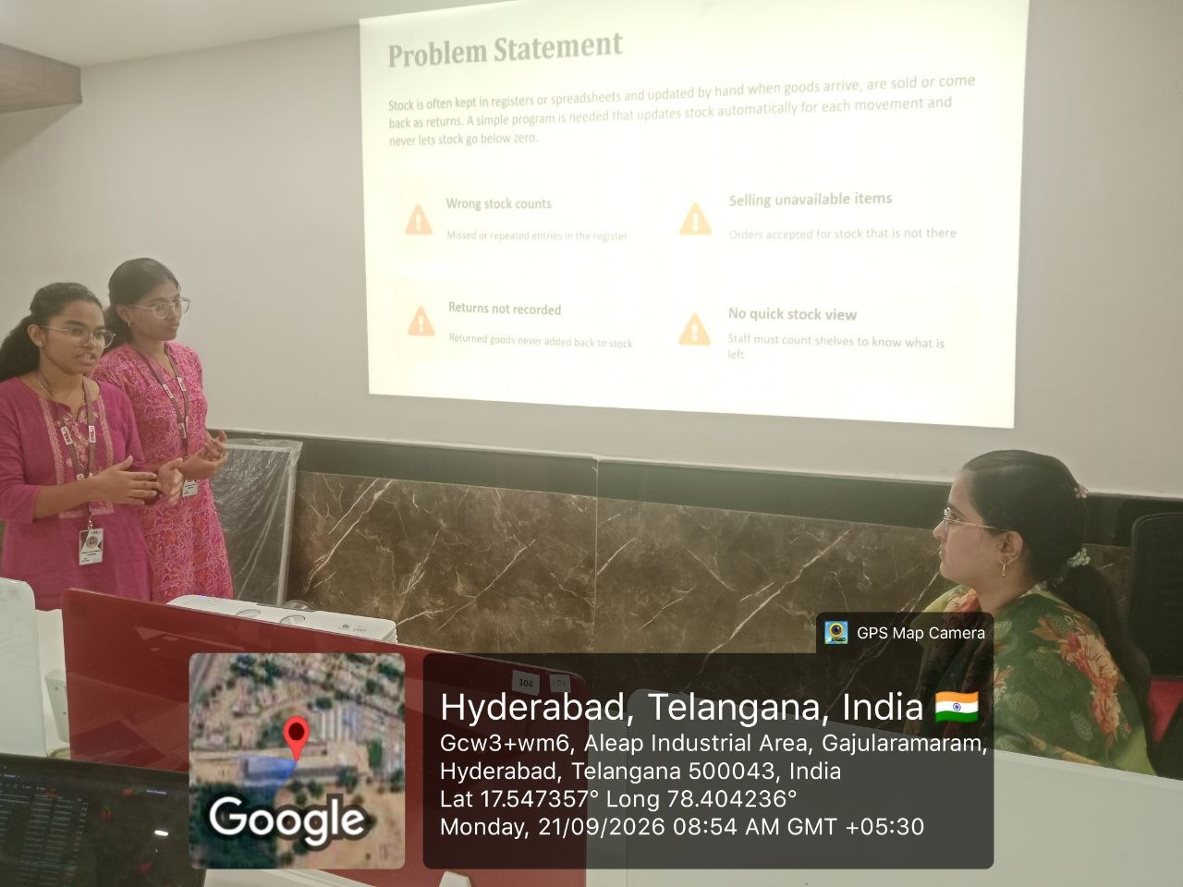
Geo-tag photo

Slide 9


